Slide 1
Video Panorama for Augmented Reality
-CYN Dwith
Sai Deepika

Slide 2
Applications of Panoramic Videos
Telepresence
Virtual Reality
Tour guides
Augmented Reality
and many more..

Slide 3
Steps
Feature Points Detection
Feature Matching
Geometric Transform Estimation
Image Stitching
Video Stitching
Video Stabilization
Video Panorama !! :D

Slide 4
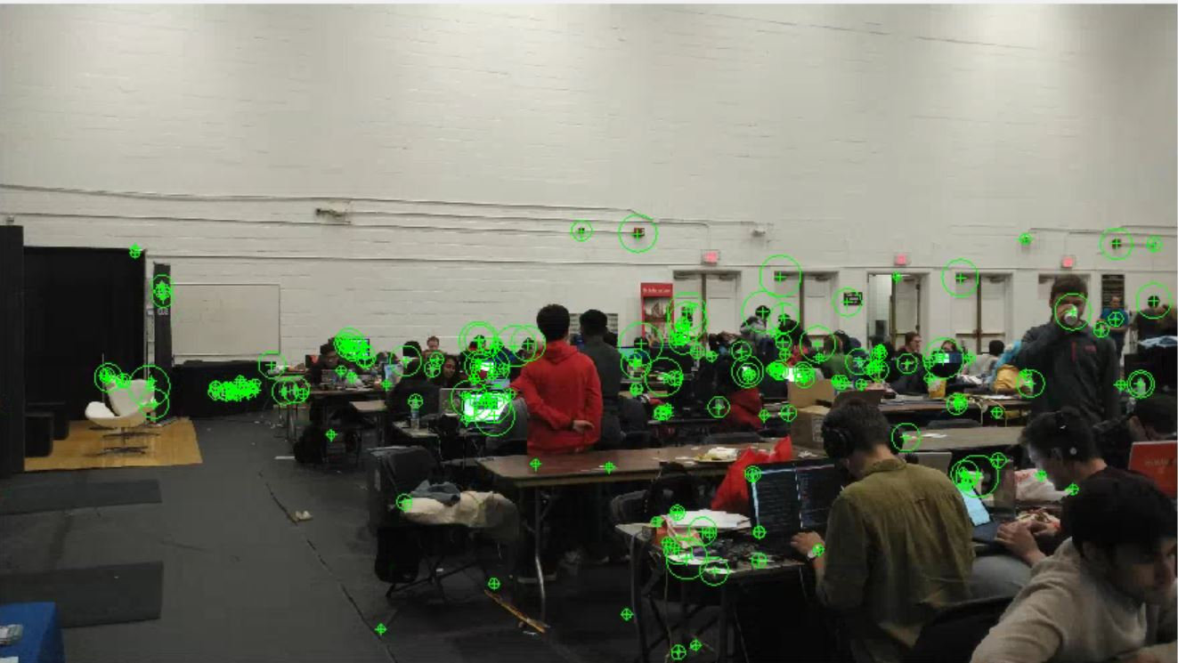
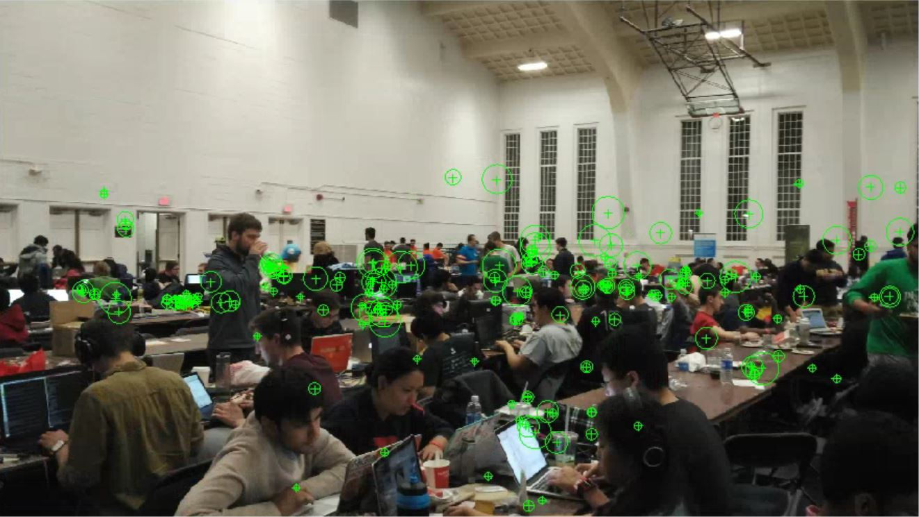
Feature Detection
A set of points that are invariant to scale, illumination is selected using the SIFT(Scale Invariant Feature Transform) or SURF(Speeded Up Robust Features) Algorithm.

Slide 5
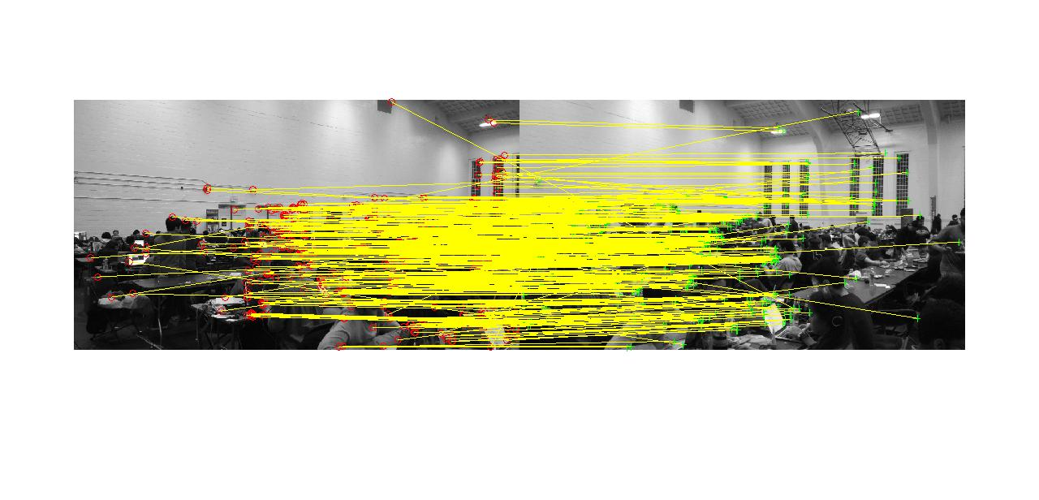
Feature Matching
The SIFT features detected in each image are matched in the two images.

Slide 6
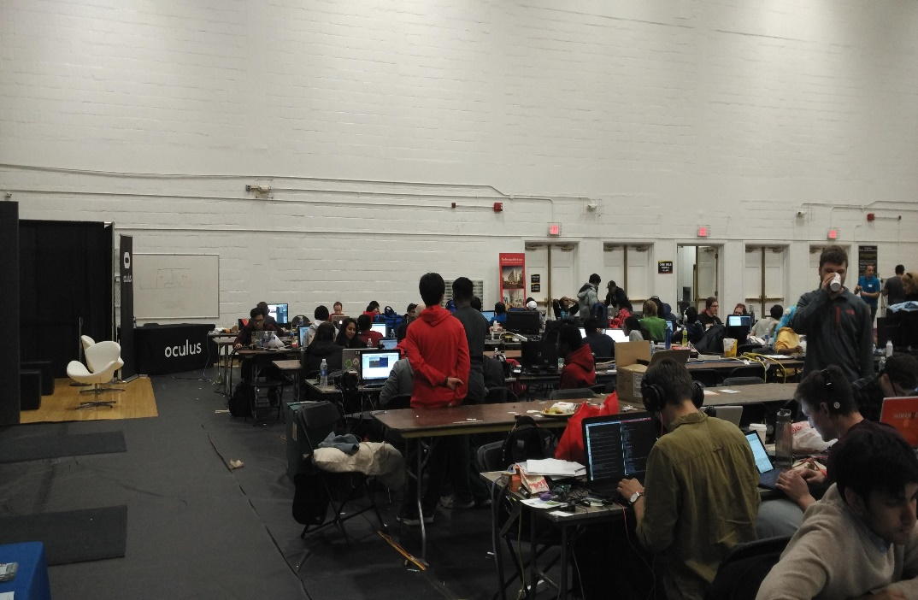
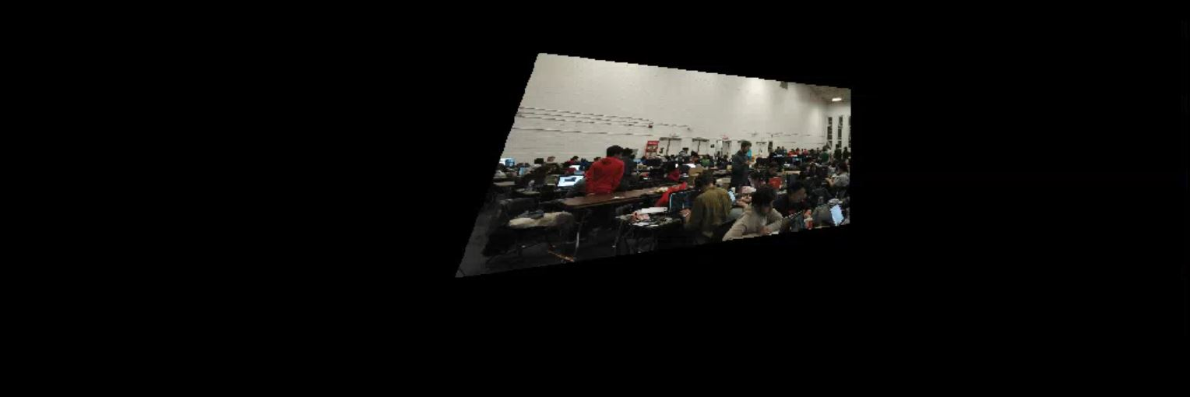
Geometric Transformation
Original Image
Geometrically transformed image that goes to the panorama output

Slide 7
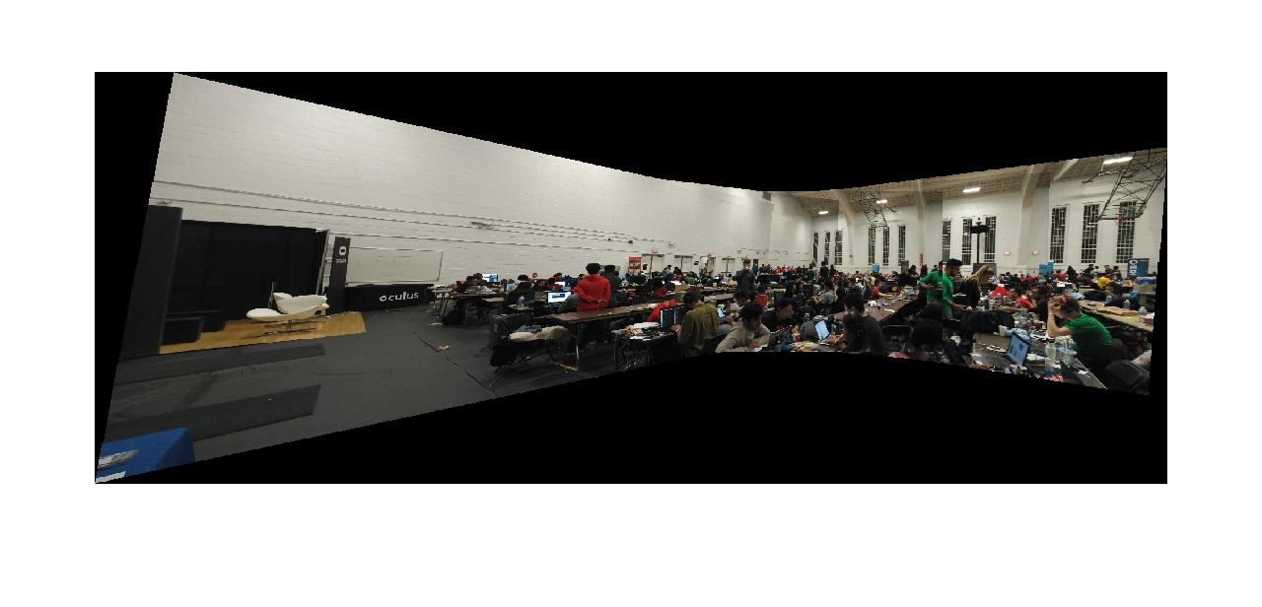
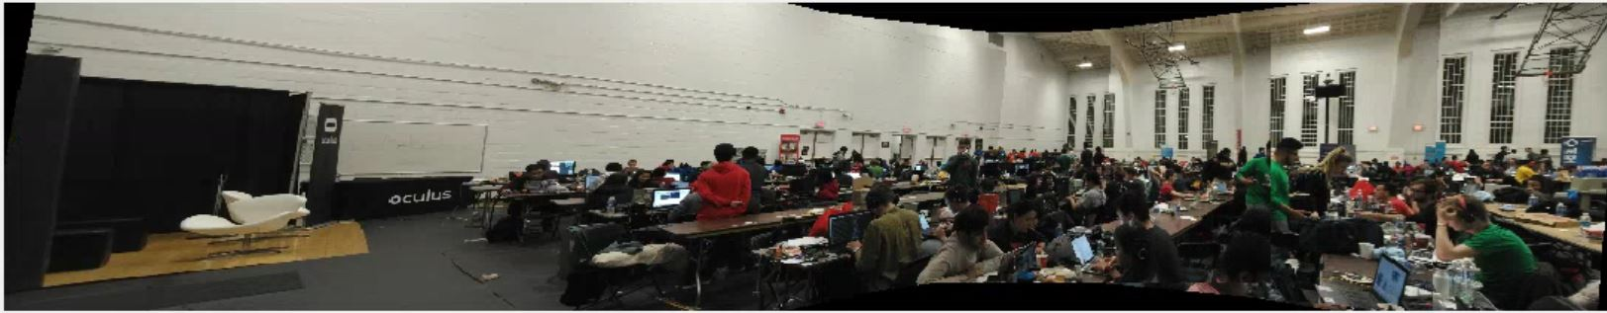
Image Stitching/Blending

Slide 8
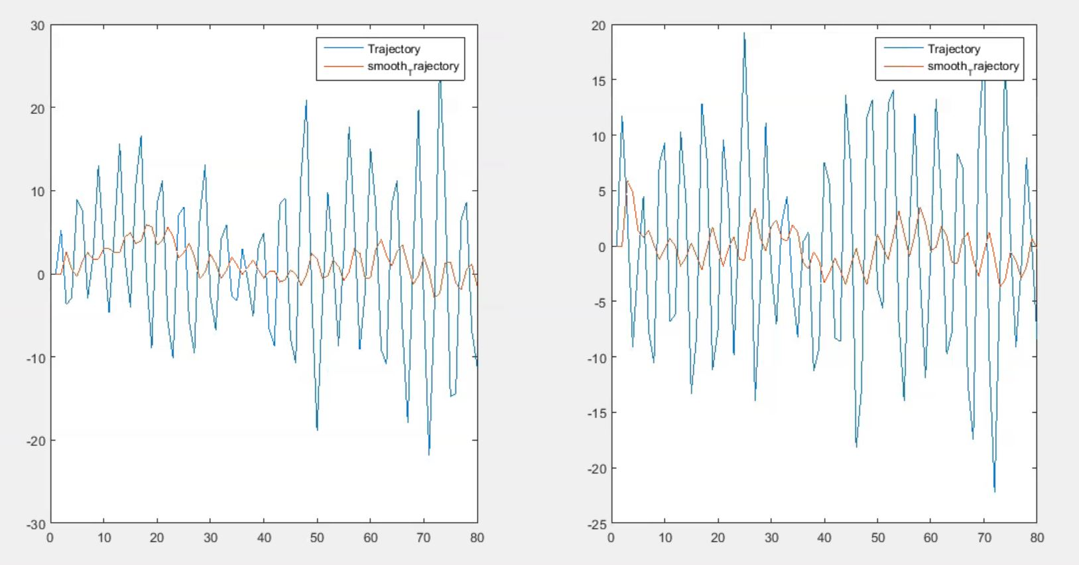
Video Stabilization
The unstable video is stabilized by smoothing out the camera trajectory. The figure shows horizontal and vertical motion and its projective smooth camera motion.

Slide 9
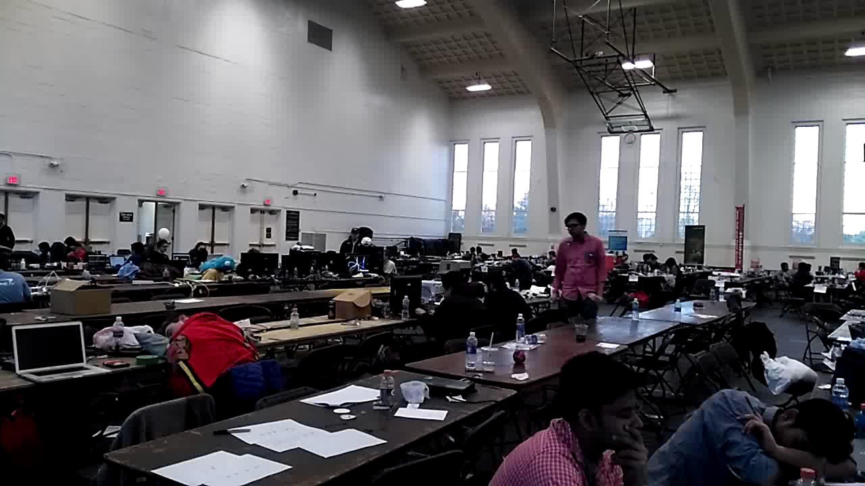
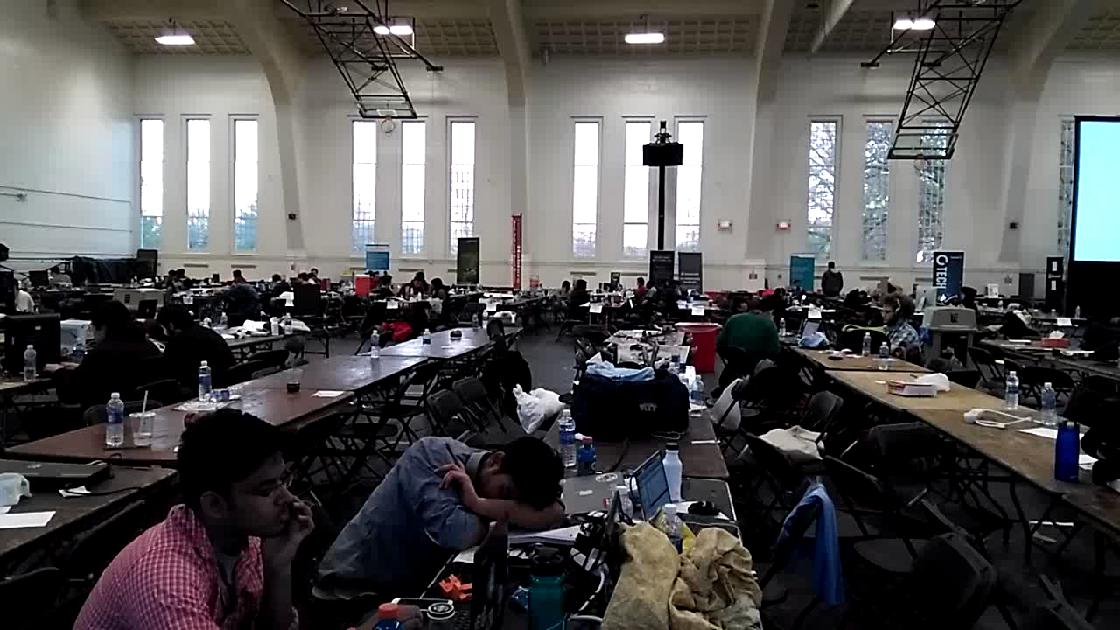
Video Panorama demo

Slide 10
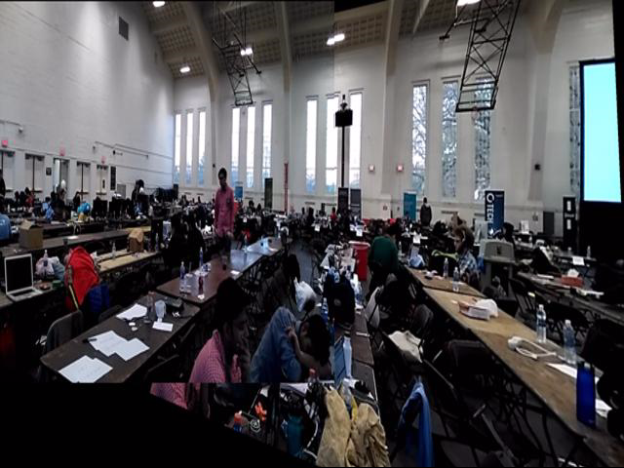
Video Panorama demo (Contd..)

Slide 11
References
MATLAB documentation on Image processing, Computer Vision, Video Processing and Video Acquisition toolboxes.
Barbara Zitova ́*, Jan Flusser,"Image registration methods: a survey", Image and Vision Computing (Elsevier)
MATTHEW BROWN∗ AND DAVID G. LOWE, 'Automatic Panoramic Image Stitching using Invariant Features", International Journal of Computer Vision.
Avinash Ravichandran and Ren ́e Vidal , “Video Registration using Dynamic Textures”
Simple Video Stabilization using OpenCV http://nghiaho.com/?p=2093

